Slide 1

Home Security Alarm System

Slide 2
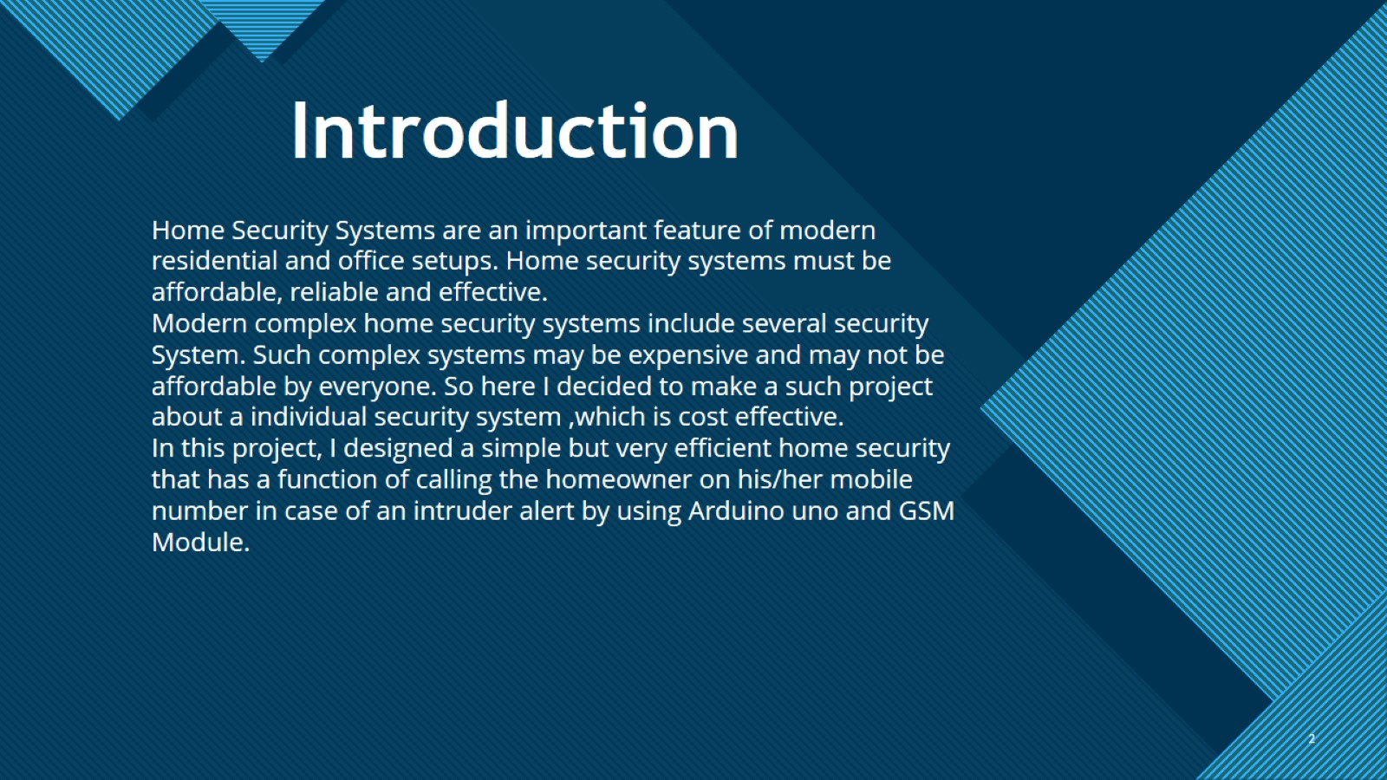
Introduction

Slide 3
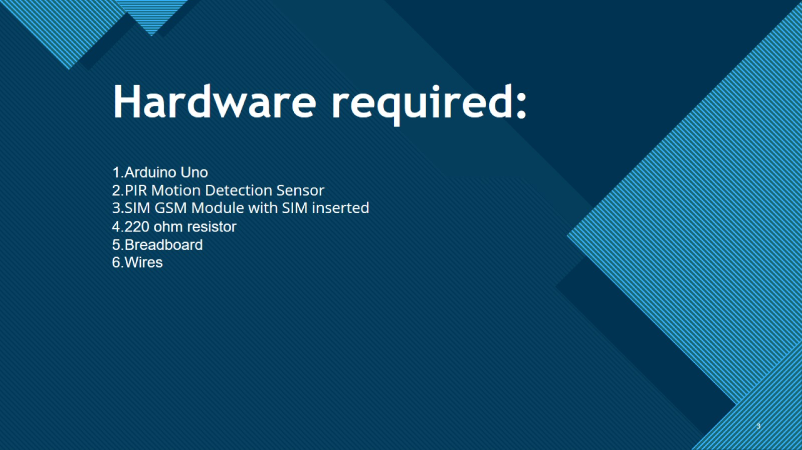
Hardware required:

Slide 4

Why I choose the project:

Slide 5
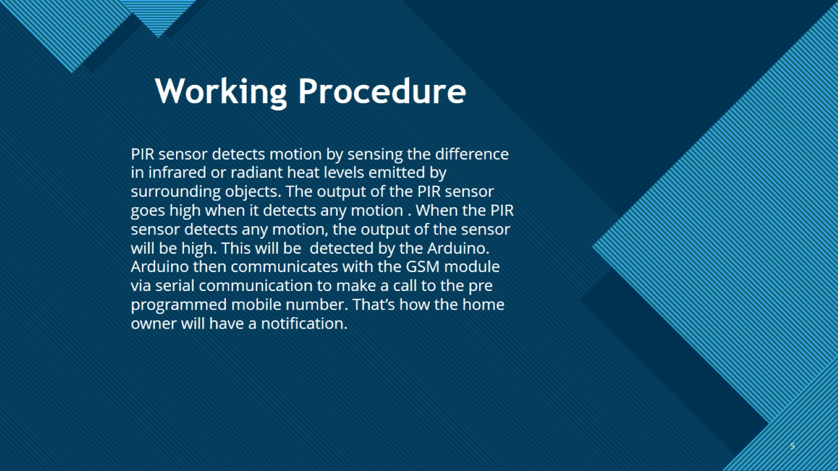
Working Procedure

Slide 6
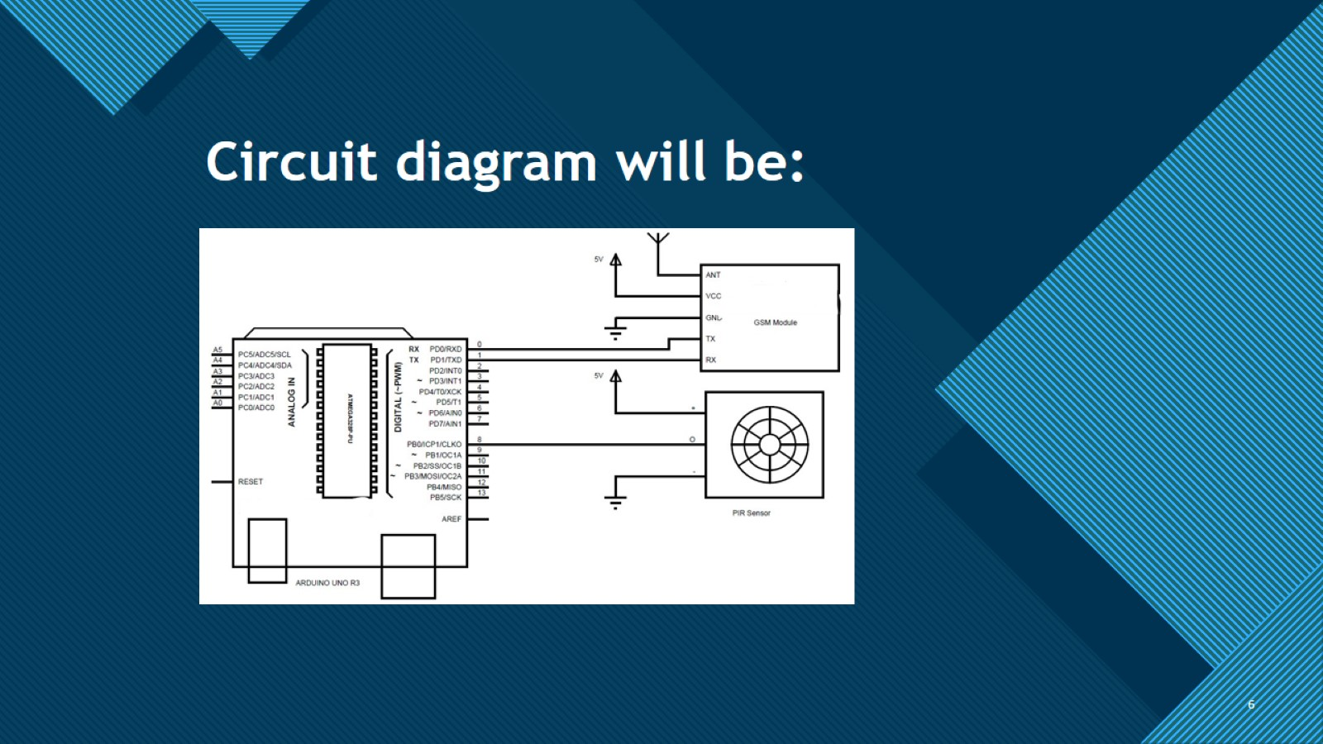
Circuit diagram will be:

Slide 7

Thank You

